Slide 1
Create Multi-Platform Apps With .NET MAUI and the MAUI Community Toolkit: Empowering .NET Developers for Cross-Platform Success
Tools and techniques for efficient cross-platform development
Notes:
AI-generated content may be incorrect. --- Welcome to this presentation on building multi-platform applications using .NET MAUI and the MAUI Community Toolkit. This session is designed to empower .NET developers with the knowledge and tools to create efficient cross-platform apps.

Slide 2

Presentation Agenda
About Me: Speaker Introduction
Introduction to .NET MAUI and Cross-Platform App Development
Development Tools for Windows and macOS
Rapid App Building With XAML, C#, and VS Code
Enhancing Apps With the .NET MAUI Community Toolkit
Simplifying Architecture With the MVVM Pattern and MVVM Toolkit
Building MAUI Apps With C# Markup: No XAML Required
Styling Apps With CSS and Web Style Reuse in .NET MAUI
Accessing Platform-Specific Features With .NET MAUI
Q&A: Your .NET MAUI App Development Questions Answered
Notes:
--- We will cover an introduction to .NET MAUI, development tools, rapid app building techniques, enhancing apps with the MAUI Community Toolkit, architectural patterns like MVVM, styling options, platform-specific features, and conclude with a Q&A session. Image source: Microsoft 365 content library

Slide 3
About Me: Speaker Introduction
Notes:
Let me introduce myself, sharing my professional background with .NET development, experience in cross-platform app creation, and notable projects along with community involvement that enrich my expertise.

Slide 4

Professional Background and Expertise with .NET
Extensive .NET Experience
Proven expertise in building applications using the comprehensive .NET ecosystem across multiple industries.
Cross-Domain Application Development
Skilled in creating versatile applications tailored for various business domains and user needs.
Up-to-Date with .NET Advancements
Continuously learning and integrating the latest .NET technologies to enhance application performance and features.
Notes:
--- I have extensive experience working with the .NET ecosystem, developing applications across various domains, and staying current with the latest advancements in .NET technologies. Image source: Microsoft 365 content library

Slide 5

Experience with Cross-Platform Development
Cross-Platform Tools
Xamarin and .NET MAUI enable development of apps for multiple platforms with shared codebase.
Challenges Faced
Developing for multiple platforms involves addressing compatibility and performance challenges.
Practical Solutions
Applying best practices helps overcome issues and optimize cross-platform app performance.
Notes:
--- My work includes building cross-platform apps using Xamarin and .NET MAUI, giving me practical insights into the challenges and solutions in multi-platform software development. Image source: Microsoft 365 content library

Slide 6

Notable Projects and Community Involvement
Open-Source Contributions
Contributed code and improvements to various open-source .NET projects, enhancing functionality and collaboration.
Community Participation
Active member of developer communities, engaging in discussions and sharing knowledge on .NET topics.
Workshops and Talks
Delivered educational talks and workshops to empower others in mastering .NET development skills.
Notes:
--- I have contributed to open-source projects, participated in developer communities, and delivered talks or workshops to help others succeed in .NET development. Image source: Microsoft 365 content library

Slide 7
Introduction to .NET MAUI and Cross-Platform App Development
Notes:
This section introduces .NET MAUI, the platforms it supports, and why using a single codebase simplifies development for iOS, Android, macOS, and Windows.

Slide 8

Overview of .NET MAUI and Supported Platforms
Multi-platform Framework
.NET MAUI allows building apps for multiple platforms using a single shared codebase.
Supported Platforms
.NET MAUI supports major desktop and mobile operating systems enabling cross-device compatibility.
Notes:
--- .NET MAUI stands for Multi-platform App UI, enabling developers to build apps across major desktop and mobile platforms with one framework and codebase. Image source: Microsoft 365 content library

Slide 9
Benefits of a Single Codebase for iOS, Android, macOS, and Windows
Reduced Maintenance Effort
A single codebase simplifies updates and bug fixes, lowering the time and resources needed for maintenance.
Faster Development
Developers can build and deploy features faster by writing code once for all platforms.
Consistent User Experience
Using a unified codebase ensures users enjoy the same experience across devices and operating systems.
Notes:
--- A unified codebase reduces maintenance effort, speeds up development, and allows code reuse, making it easier to deliver consistent experiences across devices. Image source: Microsoft 365 content library

Slide 10

Key Differences From Xamarin and Other Frameworks
Improved Architecture
.NET MAUI features a better architecture than Xamarin.Forms for more maintainable and scalable apps.
Enhanced Performance
.NET MAUI offers enhanced performance, enabling faster and more efficient app execution compared to Xamarin.
Streamlined Project Structure
.NET MAUI simplifies project structure, making it easier for developers to manage and build applications.
Notes:
--- .NET MAUI improves upon Xamarin.Forms with better architecture, enhanced performance, and streamlined project structure, offering a more modern development experience. Image source: Microsoft 365 content library

Slide 11
Development Tools for Windows and macOS
Notes:
Explore the integrated development environments and tools available on Windows and macOS to build, debug, and deploy .NET MAUI applications efficiently.

Slide 12

Overview of Available IDEs and Tools
Primary IDEs
Visual Studio on Windows and macOS serves as the main integrated development environments for .NET MAUI development.
Supporting Tools
VS Code and command-line tools complement the primary IDEs by supporting flexible and lightweight development workflows.
Notes:
--- Visual Studio on Windows and macOS are primary IDEs, complemented by VS Code and command-line tools that support .NET MAUI development workflows. Image source: Microsoft 365 content library

Slide 13

Debugging and Building Across Platforms
Debugging Tools Usage
Use debugging tools to identify and fix issues effectively during development across platforms.
Simulators and Emulators
Simulators and emulators replicate different platforms, enabling real-time testing without physical devices.
Cross-Platform Testing
Test applications seamlessly across multiple platforms from a single development environment to ensure compatibility.
Notes:
--- Learn how to leverage debugging tools, simulators, and emulators to test applications on different platforms directly from your development environment. Image source: Microsoft 365 content library

Slide 14

Tips for Maximizing Productivity
Hot Reload Feature
Hot reload enables instant code changes, speeding up development and reducing testing time.
Use of Templates
Templates provide reusable structures, enhancing consistency and saving time during coding.
Extensions for Quality
Extensions add functionality and help maintain high code quality across different platforms.
Notes:
--- Utilize features like hot reload, templates, and extensions to speed up development and maintain high code quality across platforms. Image source: Microsoft 365 content library

Slide 15
Rapid App Building With XAML, C#, and VS Code
Notes:
This section covers setting up your environment and creating user interfaces using XAML and C# to build apps rapidly, even when using VS Code.

Slide 16

Setting up Your Development Environment
Essential SDK Installation
Install required software development kits to enable .NET MAUI app development on your machine.
Integrated Development Environments
Set up IDEs like Visual Studio or VS Code with relevant extensions for efficient coding.
Tool Configuration
Configure development tools and extensions to streamline building and testing .NET MAUI applications.
Notes:
--- Configure your machine with necessary SDKs, IDEs, and tools to start building .NET MAUI apps, including installation of Visual Studio or VS Code extensions. Image source: Microsoft 365 content library

Slide 17

Building User Interfaces with XAML and C#
XAML for UI Design
XAML markup enables clear and declarative UI design for building flexible user interfaces.
C# Code-Behind Control
C# code-behind provides programmatic control to manage UI behavior and responsiveness dynamically.
Responsive and Maintainable UI
Combining XAML and C# results in responsive, flexible, and maintainable user interfaces.
Notes:
--- Understand how to design responsive and maintainable UIs using XAML markup and C# code-behind for flexibility and control. Image source: Microsoft 365 content library

Slide 18

Tips for Efficient Development Workflows in VS Code
Utilize IntelliSense
Leverage IntelliSense for code completion and real-time suggestions to speed up coding.
Use Debugging Tools
Integrate debugging features in VS Code to quickly identify and fix issues during development.
Install Useful Extensions
Enhance development by adding extensions that support languages, themes, and productivity tools.
Notes:
--- Discover best practices for leveraging VS Code features like IntelliSense, debugging, and extensions to streamline your development process. Image source: Microsoft 365 content library

Slide 19
Enhancing Apps With the .NET MAUI Community Toolkit
Notes:
Explore the powerful controls, extensions, and behaviors provided by the Community Toolkit to accelerate development and enhance app capabilities.

Slide 20

Overview of Controls, Extensions, and Behaviors
Reusable UI Components
Toolkit provides reusable components that speed up UI development and maintain consistency.
Functionality Enhancements
Extensions add new features that extend the capabilities of existing UI elements.
Improved Responsiveness
Behaviors improve app responsiveness by managing user interactions smoothly.
Notes:
--- The toolkit offers reusable components that simplify UI development, add new functionality, and improve app responsiveness. Image source: Microsoft 365 content library

Slide 21

Practical Examples of Toolkit Features
Real-World Use Cases
Showcases practical scenarios where toolkit features address typical development problems effectively.
Feature Integration
Highlights how multiple toolkit features combine seamlessly to provide comprehensive solutions.
Solving Challenges
Demonstrates the toolkit’s role in overcoming common obstacles in software development workflows.
Notes:
--- See real-world use cases demonstrating how the toolkit’s features can be integrated to solve common development challenges. Image source: Microsoft 365 content library

Slide 22

Integrating Extensions for Productive Development
Toolkit Extensions
Extensions enhance development environments by adding useful features and functionalities.
Boost Productivity
Integrating extensions streamlines workflows and accelerates coding efficiency.
Maintain Cleaner Code
Extensions help enforce coding standards and reduce errors for cleaner, maintainable code.
Notes:
--- Learn how to incorporate toolkit extensions into your projects to boost productivity and maintain cleaner code. Image source: Microsoft 365 content library

Slide 23
Simplifying Architecture With the MVVM Pattern and MVVM Toolkit
Notes:
Understand the Model-View-ViewModel architectural pattern and how the MVVM Toolkit supports scalable and maintainable app architectures.

Slide 24

Introduction to MVVM in .NET MAUI
Separation of Concerns
MVVM clearly separates user interface from business logic for cleaner and modular code design.
Improved Code Organization
Using MVVM enhances code maintainability and organization in .NET MAUI applications.
Easier Testing
MVVM facilitates unit testing by isolating business logic from UI elements.
Notes:
--- MVVM separates UI from business logic, enabling better code organization and easier testing in .NET MAUI applications. Image source: Microsoft 365 content library

Slide 25

Leveraging the MVVM Toolkit to Reduce Boilerplate
Minimizing Repetitive Code
The MVVM Toolkit offers base classes designed to reduce repetitive coding tasks efficiently.
Streamlining Development
Helpers in the MVVM Toolkit streamline the development process, enhancing productivity and maintainability.
Notes:
--- The MVVM Toolkit provides base classes and helpers that minimize repetitive code and streamline development. Image source: Microsoft 365 content library

Slide 26

Best Practices for Scalable Cross-Platform Apps
Data Binding
Use data binding to synchronize UI and data models efficiently, enhancing app responsiveness and maintainability.
Command Patterns
Apply command patterns to encapsulate requests as objects, facilitating flexible and reusable code.
Dependency Injection
Use dependency injection to manage component dependencies, promoting modular and testable code architecture.
Notes:
--- Implement design principles such as data binding, command patterns, and dependency injection to build robust, scalable apps. Image source: Microsoft 365 content library

Slide 27
Building MAUI Apps With C# Markup: No XAML Required
Notes:
Explore an alternative approach to UI development using pure C# markup, offering advantages in flexibility and dynamic UI creation.

Slide 28
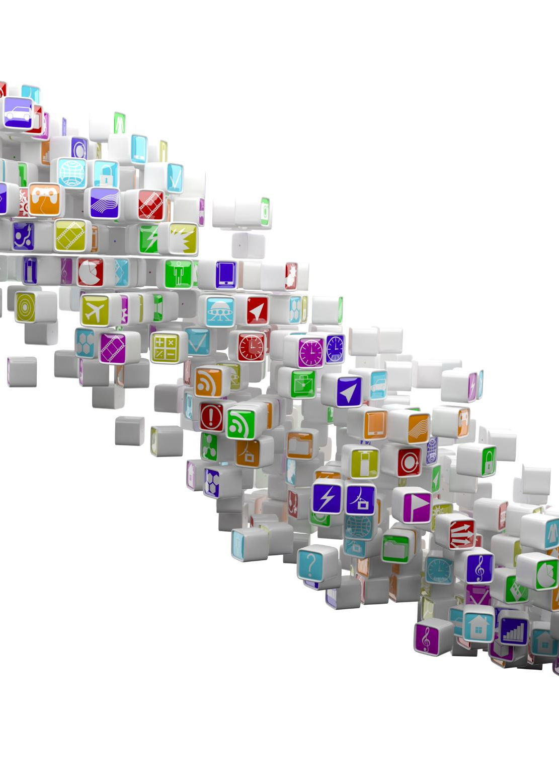
Advantages of Using C# Markup
Programmatic UI Creation
Developers can create and modify user interface elements using C# markup programmatically.
Improved Code Reuse
C# markup enhances code reuse by allowing modular UI components to be managed efficiently.
Reduced Context Switching
Using C# markup reduces context switching between design and code environments for developers.
Notes:
--- C# markup allows developers to create and modify UI elements programmatically, which can improve code reuse and reduce context switching. Image source: Microsoft 365 content library

Slide 29

Creating Dynamic UIs Purely in C#
Runtime UI Generation
Create user interface elements on-the-fly during application runtime using C# code for flexibility.
Enhanced Adaptability
Building UIs dynamically improves adaptability to complex and changing application requirements.
Pure C# Implementation
All UI components and logic are implemented purely in C# without relying on external tools or markup.
Notes:
--- Learn techniques to build user interfaces dynamically at runtime fully in C#, enhancing adaptability for complex scenarios. Image source: Microsoft 365 content library

Slide 30

Code Samples and Recommended Scenarios
Dynamic Layouts
C# markup enables flexible, dynamic layouts that adjust automatically based on data and user interactions.
Data-Driven UI Generation
UI elements can be generated dynamically from data sources, improving responsiveness and customization.
Notes:
--- Review practical examples where C# markup shines, such as dynamic layouts and scenarios where UI needs to be generated based on data. Image source: Microsoft 365 content library

Slide 31
Styling Apps With CSS and Web Style Reuse in .NET MAUI
Notes:
Discover how to leverage CSS for styling your apps, enabling reuse of existing web styles and ensuring consistent design across platforms.

Slide 32
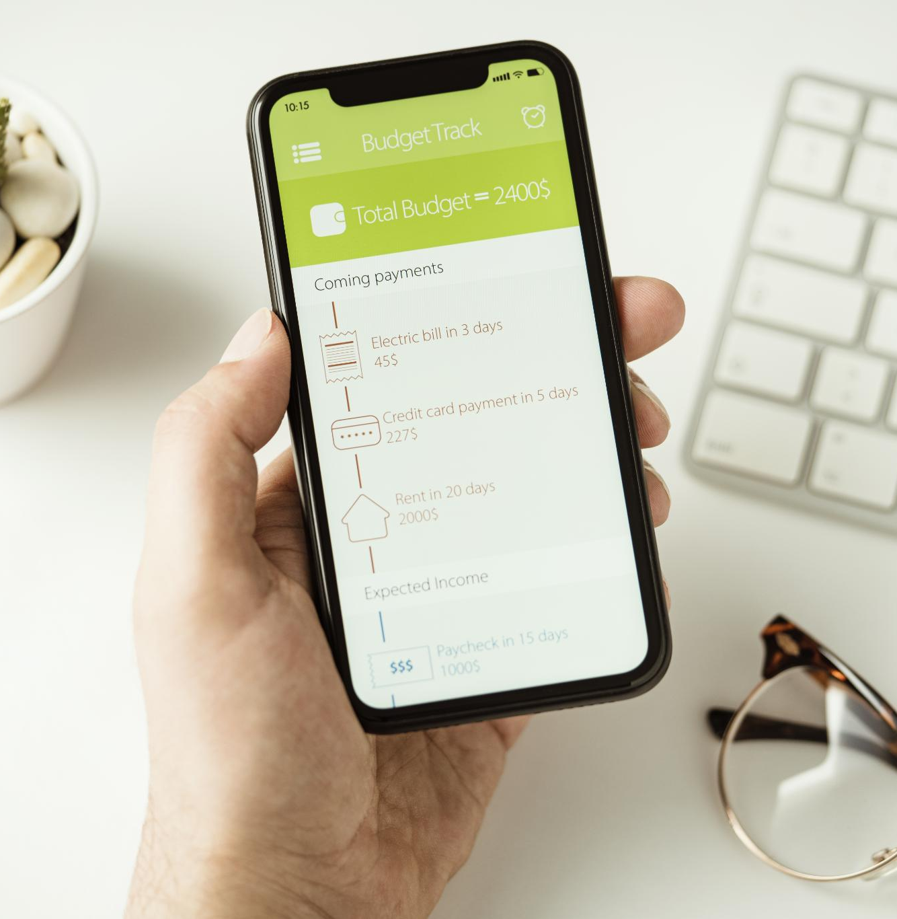
Importing and Using CSS in MAUI Projects
Including CSS Files
Learn the process to import CSS files into a MAUI project to manage styles separately from code logic.
Applying Styles to Controls
Apply CSS styles effectively to UI controls for a clear separation between design and application logic.
Notes:
--- Learn how to include CSS files in your MAUI project and apply styles to controls to separate design from logic effectively. Image source: Microsoft 365 content library

Slide 33

Reusing Existing Web Styles
Leverage Web Development Skills
Utilize your existing web development knowledge to efficiently style MAUI applications.
Save Development Time
Reusing web assets reduces styling time, accelerating app development and deployment.
Maintain Brand Consistency
Consistent styling across web and MAUI apps ensures strong and uniform brand identity.
Notes:
--- Use your existing knowledge and assets from web development to style your MAUI apps, saving time and maintaining brand consistency. Image source: Microsoft 365 content library

Slide 34
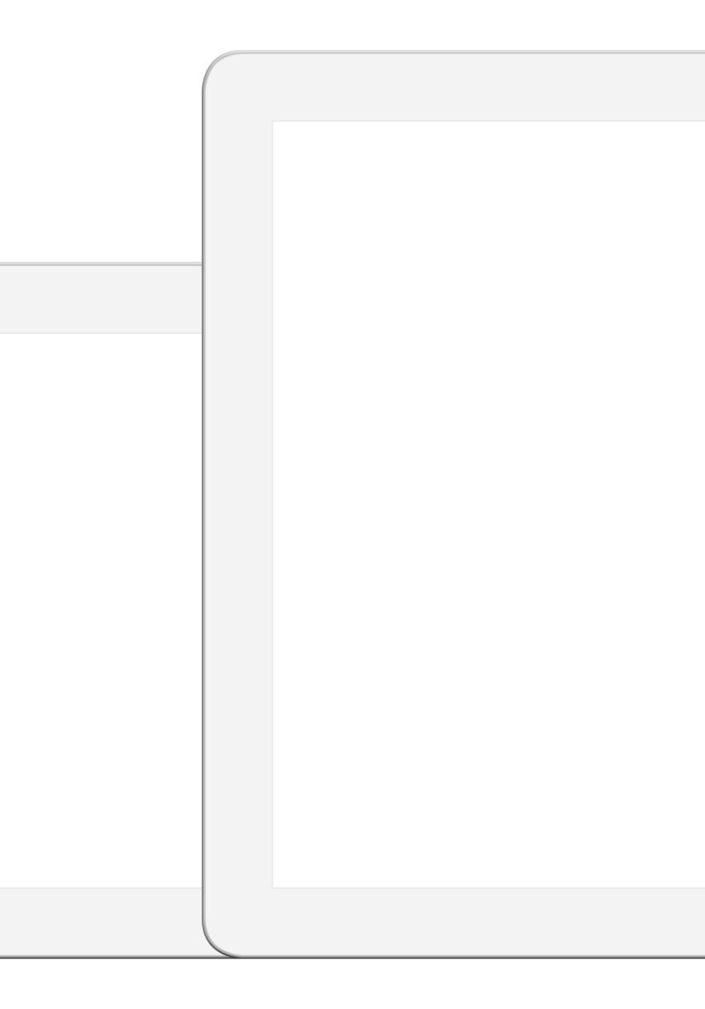
Techniques for Consistent Multi-Platform Design
Leveraging CSS
Utilize CSS to maintain consistent styling across different platforms for a unified app appearance.
Shared Stylesheets
Employ shared stylesheets to centralize design elements and ensure uniformity across devices.
Cohesive User Experience
Best practices help create a seamless and cohesive experience on various devices and screen sizes.
Notes:
--- Apply best practices to ensure your app looks and feels cohesive on different devices by leveraging CSS and shared stylesheets. Image source: Microsoft 365 content library

Slide 35
Accessing Platform-Specific Features With .NET MAUI
Notes:
Learn how .NET MAUI abstracts device features, allowing you to access platform capabilities without writing separate platform-specific code.

Slide 36

Device Feature Abstraction in .NET MAUI
Unified API Access
.NET MAUI offers unified APIs simplifying feature access across multiple device platforms.
Sensors Integration
APIs enable consistent access to device sensors like accelerometers and gyroscopes across platforms.
Camera and Notifications
Support for camera usage and notification management is streamlined via cross-platform APIs.
Notes:
--- .NET MAUI provides APIs that unify access to features like sensors, cameras, and notifications across platforms. Image source: Microsoft 365 content library

Slide 37

Utilizing Platform APIs without Platform-Specific Code
Shared Codebase Advantage
Using a shared codebase reduces duplication and streamlines development across multiple platforms.
MAUI Abstractions
MAUI abstractions allow direct access to platform features without writing platform-specific code.
Simplified Maintenance
Maintaining one codebase simplifies updates and bug fixes, enhancing efficiency in app lifecycle management.
Notes:
--- Write shared code that calls platform features directly through MAUI abstractions, simplifying development and maintenance. Image source: Microsoft 365 content library

Slide 38

Real-World Examples and Use Cases
Geolocation Capabilities
Utilizing geolocation enables location-based services and real-time navigation in various applications.
Accelerometer Usage
Accelerometer sensors detect motion and orientation, enhancing user interaction and fitness tracking.
File System Access
File system access allows applications to manage and store user data efficiently and securely.
Notes:
--- See practical scenarios where platform-specific capabilities are leveraged, such as geolocation, accelerometer, and file system access. Image source: Microsoft 365 content library

Slide 39
Q&A: Your .NET MAUI App Development Questions Answered
Notes:
This is your opportunity to ask questions related to .NET MAUI development, share feedback, and get additional resources to continue your learning journey.

Slide 40

Open Floor for Attendee Questions
Encourage Open Dialogue
Invite attendees to ask questions on any covered topic or related challenges they face.
Focus on Cross-Platform Development
Address concerns and issues specifically related to building cross-platform apps using .NET MAUI.
Notes:
--- Feel free to ask about any topics covered or other challenges you face in building cross-platform apps with .NET MAUI. Image source: Microsoft 365 content library

Slide 41

Sharing Additional Resources
Documentation Access
Provides comprehensive documentation to support learning and problem solving in your field.
Tutorials and Guides
Offers step-by-step tutorials and guides to enhance practical skills and knowledge.
Community Groups
Engage with community groups to share ideas, ask questions, and collaborate on projects.
Sample Projects
Access sample projects to practice and apply new skills in real-world scenarios.
Notes:
--- Receive links to documentation, tutorials, community groups, and sample projects to deepen your understanding and skills. Image source: Microsoft 365 content library

Slide 42

Invitation to Connect and Continue Learning
Social Media Engagement
Use social media platforms to connect with peers for sharing knowledge and support in .NET MAUI development.
Community Events
Participate in community events to foster collaboration, learn new skills, and stay updated on .NET MAUI advancements.
Notes:
--- Let's stay connected through social media and community events for ongoing support and knowledge sharing in .NET MAUI development. Image source: Microsoft 365 content library

Slide 43
Conclusion
Comprehensive Overview
Reviewed essential elements of building cross-platform apps with .NET MAUI and the Community Toolkit.
Setup and Architecture
Discussed the setup process and architecture design for effective multi-platform app development.
Styling and Integration
Covered styling techniques and platform integration to build consistent user experiences.
Encouragement to Build
Encouraged attendees to start creating their own multi-platform applications today.
Notes:
We covered key aspects of building cross-platform apps with .NET MAUI and the Community Toolkit, from setup and architecture to styling and platform integration. Thank you for joining, and I encourage you to start building your own multi-platform applications today.

